Slide 1
Overview of Object-Oriented Programming (OOP)
Notes:
Type here……

Slide 2
Learning Objectives
Define what Object-Oriented Programming (OOP) is
Differentiate procedural and object-oriented approaches
Identify the 4 main principles of OOP
Recognize the benefits and purpose of OOP in software development

Slide 3
What is Object-Oriented Programming?

Slide 4
What is Object-Oriented Programming?
Object-Oriented Programming (OOP) is a programming paradigm based on the concept of objects, which represent real-world entities. These objects contain data in the form of attributes (also called properties) and behavior in the form of methods (functions).
Notes:
Class Person
Object: Jerico
Attributes (Properties – What Person has):
Name Jerico B. Garcia
Age 25
Gender Male
Nationality Filipino
Occupation Faculty
Methods (What Person Can do)
Introduces himself: “Hi, I’m Jerico, a 20-year-old IT Instructor from the Philippines.”
Talks: “Welcome to OOP!”
Celebrates birthday: His age becomes 21.

Slide 5
Classes
A class is a blueprint for creating objects, which are specific instances of the class. It defines properties (attributes) and behaviors (methods) that the objects of the class will have.
Notes:
Example: Person
Class: Person
Think of a "Person" class like a template or blueprint for people. It describes what all people have and can do.
What the Person Class Defines:
Properties (What a person has):
Name
Age
Gender
Nationality
Occupation
Methods (What a person can do):
Introduce themselves
Talk
Celebrate birthday
Work

Slide 6
OBJECT
Objects are instances of a class in object-oriented programming (OOP). They represent real-world entities or abstract concepts that contain both data (attributes) and behavior (methods).
Notes:
Class Person
Object: Jerico
Attributes (Properties – What Person has):
Name Jerico B. Garcia
Age 25
Gender Male
Nationality Filipino
Occupation Faculty
Methods (What Person Can do)
Introduces himself: “Hi, I’m Jerico, a 20-year-old IT Instructor from the Philippines.”
Talks: “Welcome to OOP!”
Celebrates birthday: His age becomes 21.

Slide 7
ACCESS MODIFIERS
Access modifiers are keywords in object-oriented programming (OOP) that control the visibility and accessibility of class members (attributes and methods). They define whether other parts of the program can access or modify these members.
Notes:
Access Modifiers (OOP)
Control the visibility of class attributes and methods.
public – Accessible from anywhere. Example: name, general methods.
private – Accessible only inside the same class. Example: age, password.
protected – Accessible within the class and its subclasses. Example: salary, inherited methods.

Slide 8
ACCESS MODIFIERS
MODIFIERS | EXAMPLE | VISIBILITY
public | public $name; | Accessible from anywhere
private | private $age; | Accessible only within the class (name mangling)
protected | protected $salary | Accessible within the class and its subclasses
Notes:
public $name;
// Can be accessed anywhere
private $age; // Only inside the class
protected $salary; // Inside class and subclasses only

Slide 9
Differentiate procedural and object-oriented approaches

Slide 10
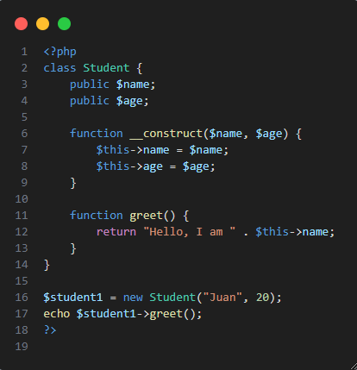
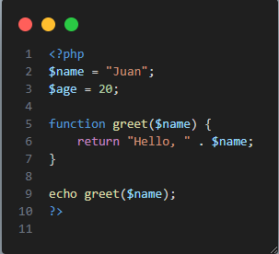
Procedural vs. Object-Oriented Programming
Procedural Programming Uses functions and steps in order Data is separate from logic Harder to reuse and maintain | Object-Oriented Programming Uses classes and objects Combines data and actions into reusable code blocks Easier to update and organize
Notes:
Procedural
Explanation:
Data like $name and $age is declared globally.
Function greet() is separate from the data.
This approach is simple but harder to manage when the program gets bigger.
OOP
All student-related data and functions are inside the class Student.
__construct() automatically assigns values when the object is created.
greet() is a method that belongs to the Student class.
$student1 is an object of the class and contains its own data.

Slide 11
The 4 Pillars of OOP

Slide 12
Abstraction
Encapsulation
-Data and functions are kept inside the class, and data is protected from direct access.
-Providing simple interfaces to interact with complex systems without exposing how they work inside.
Notes:
Encapsulation
Real-Life Computer Example: When you press the power button on a computer, it starts — but you don’t have access to or touch the internal wires, circuits, or BIOS settings. Only the power button (a function) is allowed to control the power (data).
🟩 OOP Connection: Just like the power button hides the internal power system, a class hides its internal data and lets users interact through methods only.
Abstraction
Real-Life Computer Example: When you click on a browser icon, it opens the internet — you don’t see how RAM, CPU, or operating system work in the background. You only use what’s needed: the browser window.
🟩 OOP Connection: A class can provide simple methods () while hiding the logic or code to output that methods.

Slide 13
Polymorphism
Inheritance
-A class can get the properties and behaviors of another class.
-Different classes can use the same function name, but each one behaves differently.
Notes:
Inheritance
Real-Life Computer Example: Imagine a basic computer class. A laptop and desktop can both inherit features like keyboard, processor, and screen from it. But the laptop adds a battery, and the desktop adds more ports.
🟩 OOP Connection: A Laptop class can inherit all the basic functions of a Computer class, then add or change features as needed.
Real-Life Computer Example: Pressing the Power button on a desktop starts the fan and monitor. Pressing the Power button on a laptop starts the battery and keyboard lights. Same action — different results depending on the device.
🟩 OOP Connection: A method like start() can exist in multiple classes, and each one does something different.

Slide 14
Benefits of Object-Oriented Programming (OOP)

Slide 15
1. Reusable Code
Once a class is created, it can be reused anywhere in your program or in future projects.
You can make many objects from a single class without rewriting code.
Example: A User class can be used for login, profile, and account management without rewriting functions.
2. Easier to Maintain and Debug
Since OOP keeps code organized into classes, it's easier to find and fix problems.
Each class handles its own part, so bugs are easier to locate and fix without affecting the whole system.
Example: If your login system has an error, you only check the Authentication class, not the whole application.

Slide 16
3. Scalable and Extendable
OOP makes it easy to add new features without changing existing code too much.
You can extend classes or add new ones as the system grows.
Example: Start with a User class, and later add Admin or Customer classes using inheritance.
4. Easier to Maintain and Debug
Classes help group related data and actions together.
Code becomes more readable, especially in big projects.
Developers can understand the system faster because it's well-structured.

Slide 17
Thank you

